Slide 1
Tune
Master
By,
Sathwik P S-1BY22MC046

Slide 2
01
Introduction
02
Objectives
Table of contents
03
Literature survey
04
Problem formulation
05
System design
06
Detailed design

Slide 3
Introduction
The project focuses on developing an advanced audio tuner using Python and DSP techniques for real-time note and frequency detection. Leveraging Tkinter for GUI and pyaudio for audio capture, it addresses common tuning challenges like noise handling. It targets musicians and audio professionals, enhancing precision and usability with a user-friendly interface and noise reduction settings.
Aimed at musicians and audio professionals, the project aims to develop an advanced audio tuner using Python and DSP techniques for real-time note and frequency detection. Leveraging Tkinter for GUI and pyaudio for audio capture, it addresses common tuning challenges like noise handling. It enhances precision and usability with a user-friendly interface and noise reduction settings.

Slide 4
objectives
Accurate Frequency Detection : Develop precise note identification by accurately detecting audio frequencies.
Effective Noise Reduction : Implement advanced noise reduction for reliable frequency detection in noisy environments.
User-Friendly Interface : Provide real-time audio analysis and feedback with minimal latency.
Customizable Settings : Offer adjustable parameters for tailored tuning to specific needs.

Slide 5
Literature Survey
S.NO | Title | Author | Methodology Identified | Conclusion
1. | Fundamentals of Audio Signal Processing |  | Provides detailed explanations of DSP techniques such as Fourier transforms, filtering, and spectral analysis. | Offers foundational knowledge for implementing and understanding audio signal processing crucial for tuner applications.
2. | Evaluation of Pitch Detection Algorithm |  | Comparative analysis of pitch detection algorithms like autocorrelation, cepstrum, and harmonic product spectrum. | Highlights the effectiveness of each algorithm, with cepstrum and harmonic product spectrum being particularly accurate for music applications.
3. | Real Sound Synthesis for Interactive Applications |  | Discusses various real-time audio synthesis and processing techniques, including physical modeling and sample-based synthesis. | Provides practical approaches for creating interactive and responsive audio applications, enhancing real-time performance.
4. | YIN, a Fundamental Frequency Estimator for Speech and Music |  | Introduces the YIN algorithm, which improves pitch detection by reducing pitch ambiguity and increasing robustness. | Demonstrates higher accuracy and lower error rates compared to traditional methods, making it suitable for both speech and music applications.
5. | Musical Tuning Systems |  | Explores the mathematical and theoretical foundations of various musical tuning systems, including just intonation and equal temperament. | Offers insights into the relationship between frequency ratios and perceived musical harmony, aiding in the accurate mapping of frequencies to notes.

Slide 6
Research gap
Inconsistent Noise Reduction Efficacy:
Existing solutions often struggle with effectively reducing ambient noise across diverse acoustic environments, leading to inaccurate frequency detection in real-world scenarios.
Lack of Customization Options:
  Few tuner applications offer extensive customization settings, such as adjustable noise reduction levels and volume sensitivity, limiting their adaptability to different user needs and instrument types.
Insufficient Data Logging and Analysis:
There is a lack of robust data logging features that allow users to analyze tuning patterns and improve their technique over time

Slide 7
Problem formulation
Noise Interference:
Implement advanced noise reduction techniques to accurately detect frequencies in noisy environments.
Latency Issues:
Minimize latency to provide immediate, real-time feedback for effective live tuning.
Complex User Interfaces:
Design an intuitive and user-friendly GUI for easy navigation and operation.
Limited Customization Options:
Offer extensive customization settings for noise reduction and volume sensitivity.

Slide 8
Targeted audience
Musicians
Individuals who need accurate tuning for instruments during practice, performance, and recording sessions.
Audio Engineers
Professionals requiring precise audio frequency analysis and noise reduction in studio or live environments.
Instrument technicians
Specialists who need precise tuning tools for instrument maintenance and calibration.

Slide 9
Requirements
Hardware Requirements
Processor: Quad-core Processor (e.g., Intel i3 and above or AMD Ryzen 5 and above)
Microphone and Speaker
Software Requirements
Operating System: The course registration application is compatible with all popular OS such as Windows, Mac OS and Linux also.
Python Libraries

Slide 10
Modules identified
Noise Reduction Module
Audio Capture Module
Settings Management Module
Control modules
Applies noise reduction algorithms to filter out ambient noise
Manages the real-time audio input from the microphone
Data Logging Module
Logs detected frequencies and notes, along with timestamps, for record-keeping and further analysis.
Handles user-adjustable settings such as noise reduction levels, volume division, and output directory

Slide 11
Modules identified
Recording Control Module
GUI Module
Feedback Display Module
Output Management Module
User modules
Allows users to start and stop the audio recording process, integrating with the audio capture and frequency detection modules
Provides the main interface for user interaction, displaying current frequency, detected note etc.
Allow users to remotely control the AC system via smartphone or computer.
Enables users to select output
directories and manage the storage
of recorded logs and audio files.

Slide 12
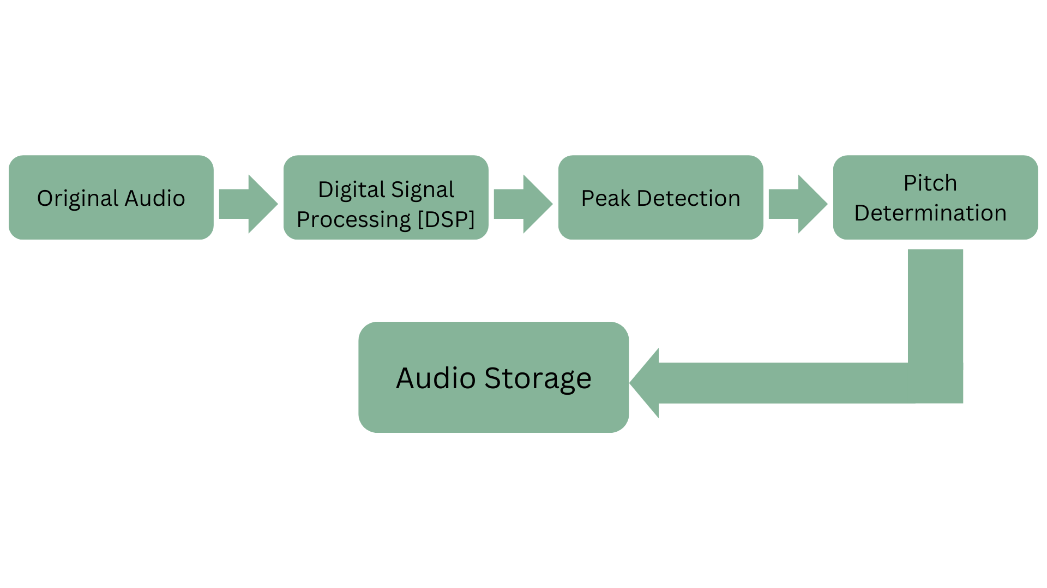
System Design

Slide 13
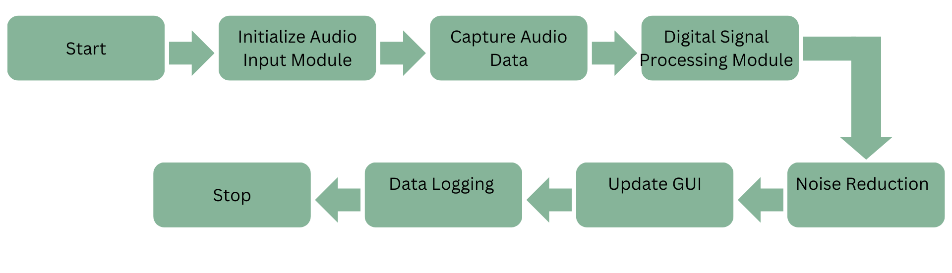

Detailed Design

Slide 14
THANK YOU

